Slide 1
github
Intro to github – how it works, server vs local
Today – everyone creates a github account and a CS1030 Repository (repo)

Slide 2
what is github?
A collaboration tool
Save snapshots of your project as you build it.
git is an application
github is a free server running git software
Each time you save a snapshot, it shows the version just saved differs from the previous version.
Work from multiple computers or collaborate with friends
Save a snapshot to the local then save (push) a version to a server (github.com) co-workers can access

Slide 3
More github
A collection of tools developed by Linux kernel group for SCM
Now used by several other groups, and apparently growing in popularity
Actually implements a replicated versioned file system
Can be used to implement a variety of software configuration management models and workflows

Slide 4
Even More github
If you switch to a different computer (or if a collaborator logged in from a different computer), "pull" a copy from gitHub, and work from exactly where you left off.
git has a LOT of commands!
Learn a core subset of them
Maybe one of the GUI tools (e.g., gitkraken)
Then learn the rest as you need them

Slide 5
Groups of Git commands
Setup and branch management
init, checkout, branch
Modify
add, delete, rename, commit
Get information
status, diff, log
Create reference points
tag, branch

Slide 6
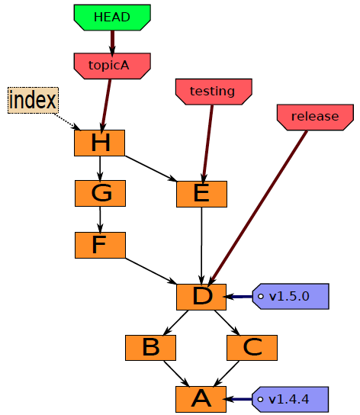
Git components
Index
“staging area”
what is to be committed
http://edgyu.excess.org/git-tutorial/2008-07-09/intro-to-git.pdf

Slide 7
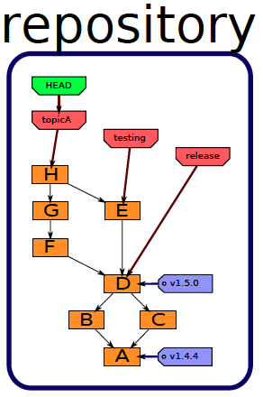
History
A database, stored in directory “.git”.
http://edgyu.excess.org/git-tutorial/2008-07-09/intro-to-git.pdf

Slide 8
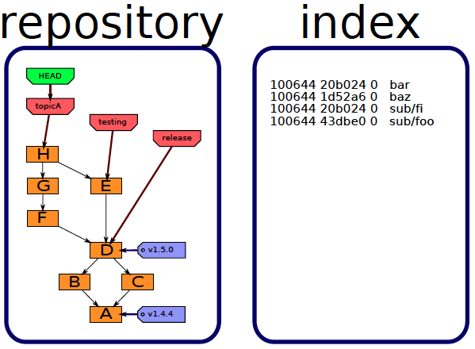
Staging area
Also stored in directory “.git”.
http://edgyu.excess.org/git-tutorial/2008-07-09/intro-to-git.pdf

Slide 9
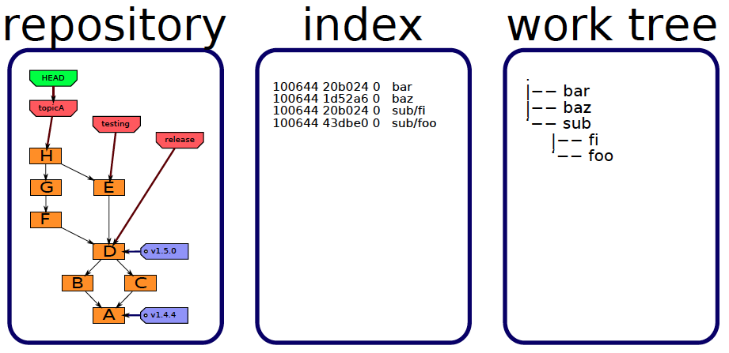
Files you edit
Stored in the directory containing directory “.git”.
http://edgyu.excess.org/git-tutorial/2008-07-09/intro-to-git.pdf

Slide 10
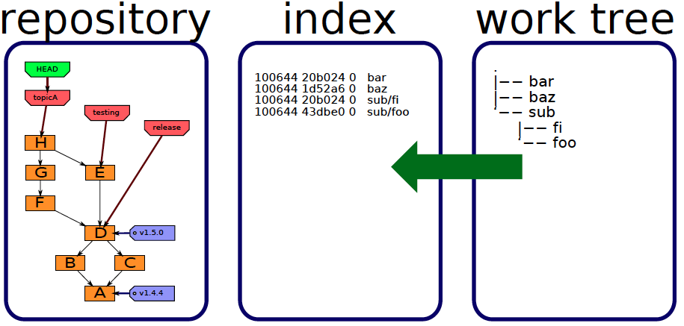
Staging
add
http://edgyu.excess.org/git-tutorial/2008-07-09/intro-to-git.pdf

Slide 11
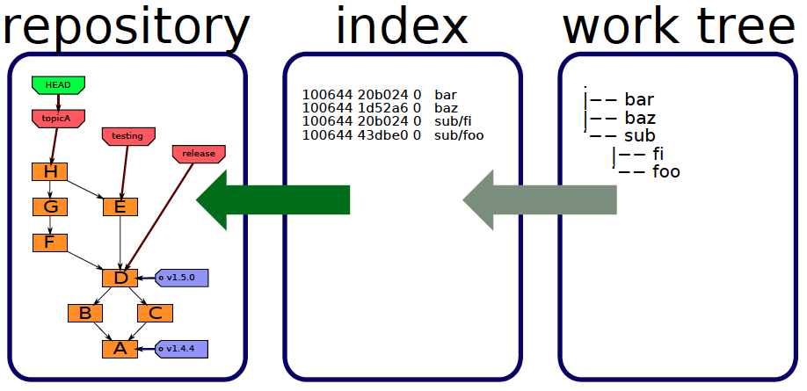
Committing
commit
http://edgyu.excess.org/git-tutorial/2008-07-09/intro-to-git.pdf

Slide 12
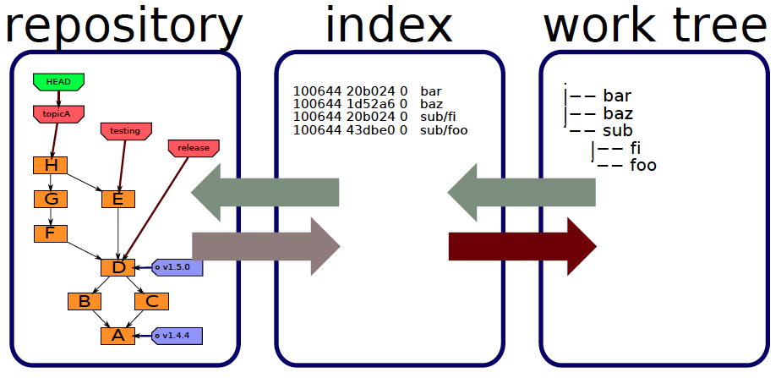
Checking out
checkout
checkout
http://edgyu.excess.org/git-tutorial/2008-07-09/intro-to-git.pdf

Slide 13
Local Operations
Repository (.git directory)
Index (staging area)
Working directory
checkout the project
add (stage) files
commit

Slide 14
Installing git
If you haven't already, create account at github.com and following the instructions
Next, install git on your computer.
One way is installing GitHub's Mac or Windows interface (or GUI), and letting its GUI take care of the rest
List of git clients:
https://git-scm.com/downloads/guis
Learn how to control Git from the command line as most developers do.
Mac Users – git comes already installed
$ git --version

Slide 15
Configuring git
First, save your user name and email in git. Only need to do this once. Make sure the username and email matches the credentials of your GitHub account. Use the following commands:
git config --global user.name "your name"
git config --global user.email your@email

